Slide 1
IEEE 802.11be Extremely High Throughput: The Next Generation of Wi-Fi Technology Beyond 802.11ax
Speaker: Sheng-Han Chung
(groundhogsh@gmail.com)
Advisor: Kai-Ten Feng, Ph.D, Professor
(ktfeng@mail.nctu.edu.tw)
Institute of Communications Engineering
National Chiao Tung University (NCTU) Hsinchu, Taiwan
July 19th, 2021

Slide 2
Outline
Introduction
Objectives and Timeline
Candidate Technical Features
320 MHz Bandwidth and More Efficient Utilization of Noncontiguous Spectrum
Multi-Band/Multi-Channel Aggregation and Operation
16 Spatial Streams and Multiple-Input Multiple-Output Protocol Enhancements
Multi-Access Point Coordination
Enhanced Link Adaptation and Retransmission Protocol
Coexistence in the 6 GHz Band
802.11be Performance Evaluation
Conclusions
References

Slide 3
Outline
Introduction
Objectives and Timeline
Candidate Technical Features
320 MHz Bandwidth and More Efficient Utilization of Noncontiguous Spectrum
Multi-Band/Multi-Channel Aggregation and Operation
16 Spatial Streams and Multiple-Input Multiple-Output Protocol Enhancements
Multi-Access Point Coordination
Enhanced Link Adaptation and Retransmission Protocol
Coexistence in the 6 GHz Band
802.11be Performance Evaluation
Conclusions
References

Slide 4
Introduction
Concurrently, the requirements of wireless data services continue to increase in many scenarios and its throughput demand will keep growing to tens of gigabits per second.
New applications demanding both high throughput and low latency are also proliferating.
The IEEE 802.11 Working Group (WG) has already initiated discussions on new technical features for bands between 1 and 7.125 GHz
We dive into the main candidate technical features of 802.11be, presenting each of them, and describing their benefits and challenges.

Slide 5
Outline
Introduction
Objectives and Timeline
Candidate Technical Features
320 MHz Bandwidth and More Efficient Utilization of Noncontiguous Spectrum
Multi-Band/Multi-Channel Aggregation and Operation
16 Spatial Streams and Multiple-Input Multiple-Output Protocol Enhancements
Multi-Access Point Coordination
Enhanced Link Adaptation and Retransmission Protocol
Coexistence in the 6 GHz Band
802.11be Performance Evaluation
Conclusions
References

Slide 6
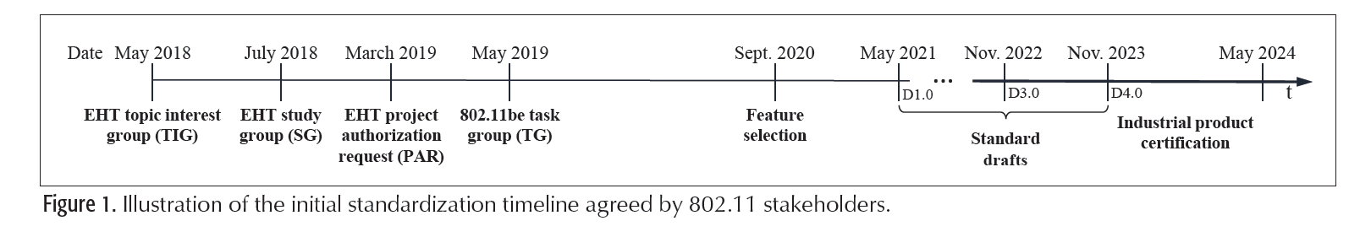
Objectives and Timeline

Slide 7
Outline
Introduction
Objectives and Timeline
Candidate Technical Features
320 MHz Bandwidth and More Efficient Utilization of Noncontiguous Spectrum
Multi-Band/Multi-Channel Aggregation and Operation
16 Spatial Streams and Multiple-Input Multiple-Output Protocol Enhancements
Multi-Access Point Coordination
Enhanced Link Adaptation and Retransmission Protocol
Coexistence in the 6 GHz Band
802.11be Performance Evaluation
Conclusions
References

Slide 8
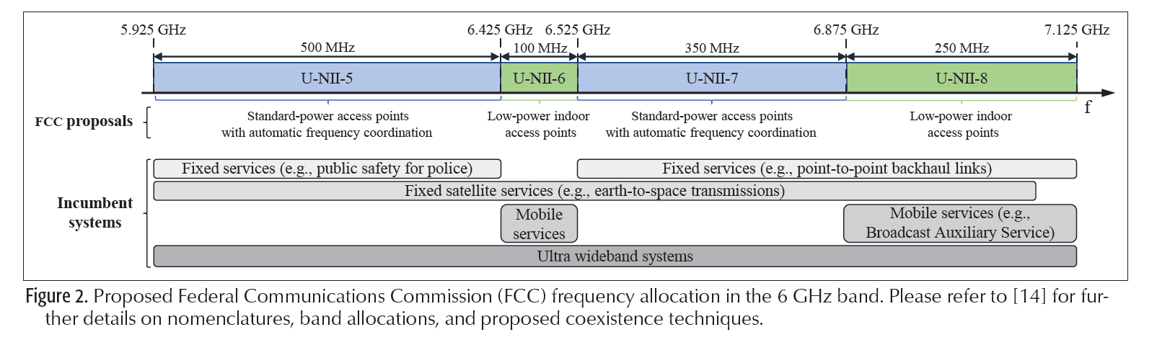
Candidate Technical Features (1/3)
320 MHz Bandwidth and More Efficient Utilization of Noncontiguous Spectrum.
Always schedule uplink transmissions in the 6GHz band, thereby reducing the time spent on channel contention.
Have the ability to request 802.11ax devices to vacate the 6 GHz band on demand, to reinforce such coordinated access.

Slide 9
Candidate Technical Features (2/3)
Multi-Band/Multi-Channel Aggregation and Operation
Multi-band data aggregation.
Simultaneous transmission and reception in different bands/channels.
Simultaneous transmission and reception in the same channel.
Data and control plane separation.
16 Spatial Streams and Multiple-Input Multiple-Output Protocol Enhancements.
802.11be upgrade the APs’ spatial multiplexing capabilities to accommodate up to 16 spatial streams.
Taking full advantage of both the high-speed backhaul provided by fiberto-the-home (FTTH) solutions and the rich scattering in indoor environments.

Slide 10
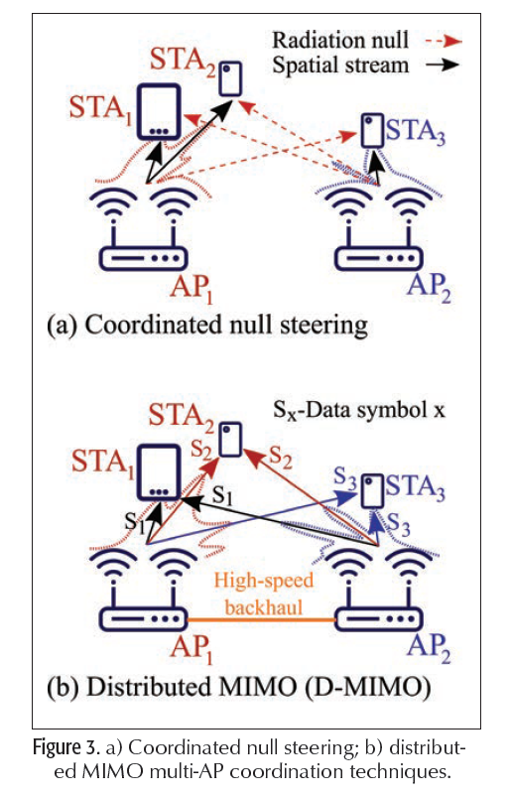
Candidate Technical Features (3/3)
Multi-Access Point Coordination
Coordinated OFDMA.
Coordinated Null Steering.
Distributed MIMO (D-MIMO).
Enhanced Link Adaptation and Retransmission
Protocol
HARQ-capable devices attempting to decode
a retransmitted MPDU combine their soft-bits
to improve the likelihood of correct decoding.

Slide 11
Outline
Introduction
Objectives and Timeline
Candidate Technical Features
320 MHz Bandwidth and More Efficient Utilization of Noncontiguous Spectrum
Multi-Band/Multi-Channel Aggregation and Operation
16 Spatial Streams and Multiple-Input Multiple-Output Protocol Enhancements
Multi-Access Point Coordination
Enhanced Link Adaptation and Retransmission Protocol
Coexistence in the 6 GHz Band
802.11be Performance Evaluation
Conclusions
References

Slide 12
Coexistence in the 6 GHz Band
Two major types of technologies are foreseen to share the 6 GHz band:
Existing — and to-be-deployed — fixed and mobile services, which can be considered as incumbents.
Newcomers, where we can distinguish between IEEE-based technologies, such as 802.11ax or 802.11be, and Third Generation Partnership Project (3GPP)-based ones, such as New Radio-Unlicensed (NR-U).
In contrast, coexistence between newcomers, such as 802.11ax/be and NR-U, is likely to be governed by listen-before-talk [2]. However, 802.11ax/be may not be treated as an incumbent technology, and thus advantages in terms of energy detection threshold may not be given
The use of a common preamble among multiple technologies to realize a cross-technology preamble detection and/or virtual carrier-sense-like mechanism has also been considered to enhance coexistence.

Slide 13
Outline
Introduction
Objectives and Timeline
Candidate Technical Features
320 MHz Bandwidth and More Efficient Utilization of Noncontiguous Spectrum
Multi-Band/Multi-Channel Aggregation and Operation
16 Spatial Streams and Multiple-Input Multiple-Output Protocol Enhancements
Multi-Access Point Coordination
Enhanced Link Adaptation and Retransmission Protocol
Coexistence in the 6 GHz Band
802.11be Performance Evaluation
Conclusions
References

Slide 14
802.11be Performance Evaluation (1/2)
More bandwidth:
802.11be-capable APs support 160 MHz transmissions in the 6 GHz band.
More antennas and spatial streams per AP:
802.11be-capable APs incorporate 16 antennas, and can spatially multiplex up to 16 STAs in downlink and uplink — doubling the number of antennas and spatial streams w.r.t. 802.11ax APs.
Implicit CSI acquisition:
802.11be-capable APs rely on STA-transmitted pilots to estimate the channel. This allows 802.11be to reduce the overhead introduced by the explicit CSI acquisition procedure of 802.11ax.

Slide 15
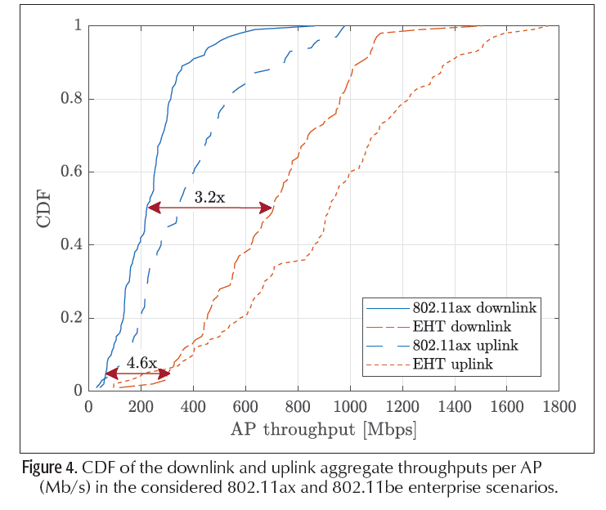
802.11be Performance Evaluation (2/2)
STAs generally experience smaller throughputs in the downlink than in the uplink in spite of the identical downlink/uplink traffic generation ratio.

Slide 16
Outline
Introduction
Objectives and Timeline
Candidate Technical Features
320 MHz Bandwidth and More Efficient Utilization of Noncontiguous Spectrum
Multi-Band/Multi-Channel Aggregation and Operation
16 Spatial Streams and Multiple-Input Multiple-Output Protocol Enhancements
Multi-Access Point Coordination
Enhanced Link Adaptation and Retransmission Protocol
Coexistence in the 6 GHz Band
802.11be Performance Evaluation
Conclusions
References

Slide 17
Conclusions
In this article, we have presented a comprehensive overview of the initial steps taken toward the creation and standardization of 802.11be and main objectives and expected timelines, shared the viewpoints of different Wi-Fi stakeholders, and discussed its main candidate features. .

Slide 18
Outline
Introduction
Objectives and Timeline
Candidate Technical Features
320 MHz Bandwidth and More Efficient Utilization of Noncontiguous Spectrum
Multi-Band/Multi-Channel Aggregation and Operation
16 Spatial Streams and Multiple-Input Multiple-Output Protocol Enhancements
Multi-Access Point Coordination
Enhanced Link Adaptation and Retransmission Protocol
Coexistence in the 6 GHz Band
802.11be Performance Evaluation
Conclusions
References

Slide 19
References
[1] D. Lopez-Perez, A. Garcia-Rodriguez, L. Galati-Giordano, M. Kasslin and K. Doppler, "IEEE 802.11be Extremely High Throughput: The Next Generation of Wi-Fi Technology Beyond 802.11ax," in IEEE Communications Magazine, vol. 57, no. 9, pp. 113-119, September 2019, doi: 10.1109/MCOM.001.1900338.

